Slide 1
DSC 530 Final Project
Lara Clasen
Spring 2019 Term

Slide 2
This data set can be found at the CDC Data Center:
https://data.cdc.gov/NCHS/NCHS-Death-rates-and-life-expectancy-at-birth/w9j2-ggv5
“This dataset of U.S. mortality trends since 1900 highlights the differences in age-adjusted death rates and life expectancy at birth by race and sex.”
[CDC, June 4, 2018]

Slide 3
5 Variables:
Year, Race, Sex, Average Life Expectancy, Age-adjusted Death Rate
Describe what the 5 variables mean in the dataset:
-The year is the point in time at which each observation is reported, ranging from the year 1900 to 2018.
-Race is the reported race of the observational groups.
-Sex is the gender of the observation, either Both Sexes, Female, or Male.
-Average Life Expectancy is the average reported life expectancy for the observational group at that point in time.
-Age-adjusted Death Rate is the death rate for that point in time that has been appropriately adjusted based on the age of the observational group.
Descriptive Statistics
Average Life Expectancy:
Mean: 64.1173
Mode: 66.8, 11 occurrences
Variance: 138.92
Standard Deviation: 11.786
Age-adjusted Death Rate:
Mean: 1621.3031
Mode: 925.8, 2 occurrences
Variance: 457501.50
Standard Deviation: 676.389

Slide 4
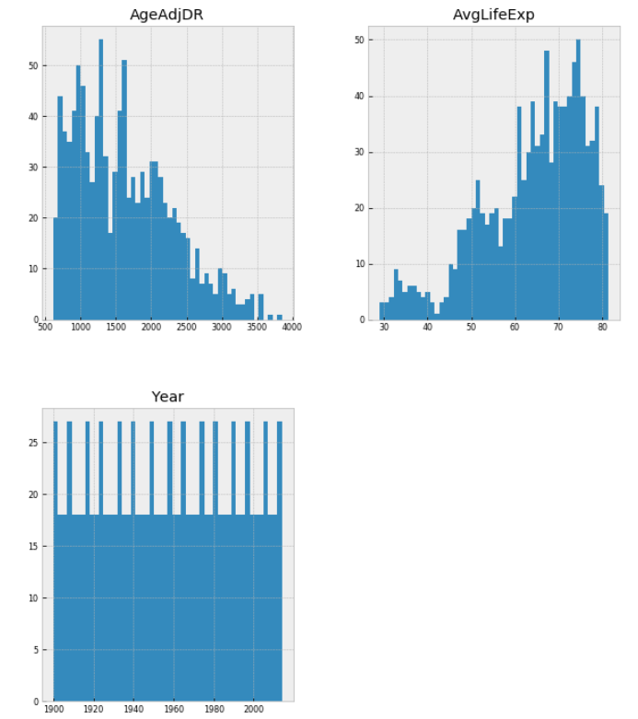
Histograms of Variables
We can see that there exist some outliers in the Age-adjusted Death Rate variable as well as the Average Life Expectancy variable.
The AADR variable appears to have some outliers above ~ 3250, and the ALE variable appears to have some outliers below 40.
For cleanest analysis, these outliers should be mediated before getting too far.

Slide 5
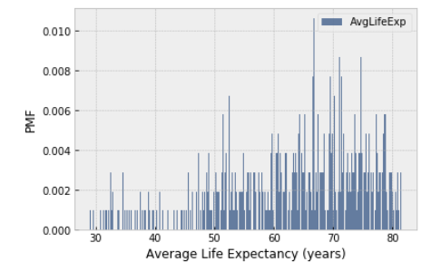
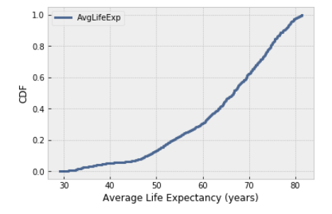
Probability Mass Function (PMF)
Average Life Expectancy in Years
This is a plot of the PMF when considering the Average Life Expectancy variable.
Cumulative Distribution Function (CDF)
Average Life Expectancy in Years
The CDF shows us some useful information if we consider percentiles. It looks like less than 10% of reported life expectancies are below 45 years, and nearly 50% of expectancies are above 60 years. Common ages of expectancy appear as the steeper portion of our line, likely between the ages of ~62 to ~75 years. Our visual representation doesn't show a clear mode.

Slide 6
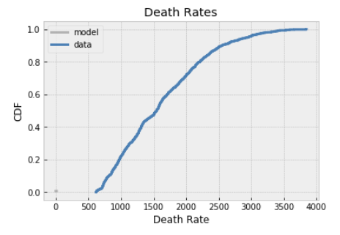
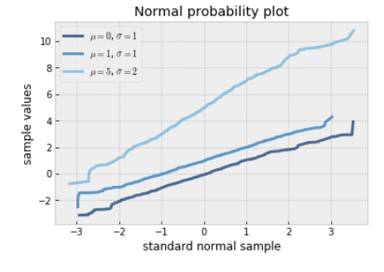
Normal Distribution Plot
This is a visual test for normality. Our plot shows that the plot is approximately straight if the data are in fact part of a normal distribution.
Observed CDF and model
Normal Probability Plot

Slide 7
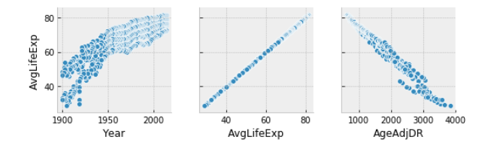
Scatterplots to Compare Variables
We can clearly identify the relationships with Average Life Expectancy. The year has a generally linear relationship, and the Age-Adjusted Death Rate has a negative linear relationship.

Slide 8
Project Summary
For my final project I used a data set of information provided by the Center for Disease Control, having originated from the National Center for Health Statistics. The data set is entitled “Death rates and life expectancy at birth”. This data set contains five columns, or variables: Year, Race, Sex, Average Life Expectancy (in years), and Age-adjusted Death Rate. The question that I sought to answer revolved around the Average Life Expectancy variable, and the correlation between that expectancy and the Year. As a society we have come to understand that life expectancy has steadily increased over the years, most drastically in comparison to many (i.e. 100) years in the past. The outcome of my exploratory analysis on this data set does communication a relevant linear relationship between the Year variable and the Average Life Expectancy variable. Therefore our understanding that later years mean a higher life expectancy is supported by these data. I feel that the main piece missing from my data wad additional variables. I fear that I may have misunderstood when I first began this project and selected a data set that has five variables but not all of these variables have the ability to be statistically analyzed for the purposes of answering my intended question. With a larger number of variables a deeper analysis could have been worked in order to obtain the best possible comprehension of the data. I would be interested in additional variables such as perhaps age of death of a parent or health status or another variable with the potential to influence life expectancy. I did face some challenges with my data set initially but I believe that I was making things more difficult than they needed to be. I was attempting to run functions essentially “from scratch” before I realized that I could utilize some of the pre-built functions provided in our textbook repository. This was incredibly helpful for me and allowed me to complete the project. However, I would like to revisit some of these concepts (for example, hypothesis testing) to try to gain a deeper understanding of how to do this, particularly when it concerns a more complex data set.

